Slide 1
House Price Prediction
Machine Learning Model

Slide 2
Problem Statement:
Houses are one of the necessary needs of each and every person around the globe and therefore housing and real estate market is one of the markets which is one of the major contributors in the world’s economy. It is a very large market and there are various companies working in the domain. Data science comes as a very important tool to solve problems in the domain to help the companies increase their overall revenue, profits, improving their marketing strategies and focusing on changing trends in house sales and purchases. Predictive modelling, Market mix modelling, recommendation systems are some of the machine learning techniques used for achieving the business goals for housing companies. Our problem is related to one such housing company. A US-based housing company named Surprise Housing has decided to enter the Australian market. The company uses data analytics to purchase houses at a price below their actual values and flip them at a higher price. For the same purpose, the company has collected a data set from the sale of houses in Australia.
Business Goal:
You are required to model the price of houses with the available independent variables. This model will then be used by the management to understand how exactly the prices vary with the variables. They can accordingly manipulate the strategy of the firm and concentrate on areas that will yield high returns. Further, the model will be a good way for the management to understand the pricing dynamics of a new market.

Slide 3
Exploratory data analysis
1 Univariate analysis
2.Bivariate analysis
3. Checking Outliers
4. Checking Skewness
5.Checking Correlation
1 Univariate analysis
1) In the MSSUbClass column the STORY 1946 & NEWER ALL STYLES type house(20) is present highest number of times in the column, The counting of 2-STORY 1946 & NEWER house(60) is also high, rest all the house types are less present and having less number of counts.
2) If we see the MSZoning column, we will find that most of the houses has been built in ths Residential Low Density(RL) Zoning and very less houses are build in the Agriculture, Commercial, Floating Village Residential, Industrial, Residential High,Density, Residential Low Density Park and Residential Medium Density MSzoning.

Slide 4
4) In our data plenty of the house's landcontour are Lvl(Near Flat/Level) and bnk(Banked), HLS(Hillside) and Low(Depression) type landcounter are very less.
5) Lot configuration is the one of the most important factor for deciding the house price.Due to less avilibility of frontage on 2 and 3 side property and high supply of insight and corner lot the houses are built inside in most of the cases and very less houses are built in FR2 and FR3 configuration.
6) Around 570 houses are one story, having same housestyle, 370 houses are One and one-half story building wherin 2nd levelis finished reflects different housestyle, approximately 30 houses are Split Foyers, 20 are One and one-half story wherein 2nd level is finished. 40 around houses are Split Level house. Rest of the housestyles which are very less in numbers are Two and one-half storys wherein 2nd level is finished in some and unfinished in others.
7) More than 800 houses have gable roof, 200 around have hip roof and very small number has got flat roofs.
8) Approximately 1130 houses are bulit of using Standard (Composite) Shingle, and 10 of Gravel & Ta, less than 10 are made up of using wood Shakes and Wood Shingles.
9) Condition of the material of 1000 houses is Average/Typical, of 180 houses is good and approximately 30 around houses are in fine condition.
10) 500 houses's foundation is made up of Cinder Block and another 500 around houses' foundation is made up of Poured Contrete. Foundation of 100 houses are build of Brick & Tile. A few numbers are there which are made up of slab, stones and wood.

Slide 5
11) 60 basements are with good living quraters, 110 are with average rest room, more than 350 are unfinished, approxamtely 120 are with Below Average Living Quarters, around 320 are with Good Living Quarters, and 160 aroud are with Average Living Quarters.
12) More than 1000 basement areas are Unfinshed. 50 around numbers of basements have Average Rec Room and Low Quality. 50 around basements have Good Living Quarters, and Average Living Quarters, also little number of basemnets have Below Average Living Quarters.
13) Approxately 1150 numbers have Gas forced warm air furnace, while the houses that haveGas hot water or steam heat are negligible.
14) More than 1000 houses have Standard Circuit Breakers & Romex. The houses that have Fuse Box over 60 AMP and all Romex wiring (Average) and 60 AMP Fuse Box and mostly Romex wiring (Fair) are very little in number.
15) In most of the houses (around 750) garage is attched and in 300 aroud houses garage is detched.
16) Around 570 houses' kicthens are typical average. 460 are good. 90 has got Excellent quality and very less are left with fair quality.
17) Warranty Deed - Conventional is very high in numbers, the Homes that just constructed and sold, are less in numbers. Around 30 houses are being sold though Court Officer Deed/Estate, while other sale types are negligible in numbers.

Slide 6
2.Bivariate analysis
1) HouseStyle and LandSlpoe- Gentle slope land is the common most slope, present in all the house style.
2) Foundation and Garage type- In the cinder block and poured contrete type fundation attched garage is being used in high amount and then detched garage.In the Brick & Tile type foundation detched garage is being used in high amount and other garage is uesd in very less amount.
3) MSZoning and LotShape- in the Residential Low Density Zone the lot shape is regular type in most of the cases and then Slightly irregular lot shape has been built, Moderately Irregular and Irregular lot shape is used in few number of houses only. In the conclusion regular type lot shape is found in all the available Mszoning.
4) PoolQC and Sale type- When good pool quality is good, house sale type is Warranty Deed-Conventional(WD) and higher in numbers, rest all the sale type is very less.
5) LotShape and GarageQual- Typical/Average garage quality is higher in all type of lot shape, In the Moderately Irregular, Irregular lot shape only Typical/Average lot shape is avilable and in the regular lot shape, garage quality fair and good is avilabe but in the negligible amount and again Typical/Average garage quality is higher in regular lot shape.
6) MSZoning and Fence- In the Residential Low Density Zone, Minimum Privacy fence is avilable in huge amount and very less availability of good privacy, good wood and minimum wood type fencing And alos we can say that in all the zoning mimimum privacy type fence is present.

Slide 7
3. Checking Outliers
1) In Our dataset some columns have outliers, As we can see LotFrontage column the mean is 68.97 and standard daviation is 22.83 and also the maximum value is 313 means the data are highly spreded therefor the chances of outliers are present.
2) Similarly in the LotArea mean is 10484 and the standard daviation is 8957 and the maximum values is 164660, shows that outliers are present in this column.
3) In the MasVnrArea column and BsmtFinSF2 column outliers are present. mean is 101.69 and max vlaue is 1600 for Masvnrarea mean is 46.64 and max is 1474 for BsmtFinSF2
WHich shows the data are highly spreded in these column.
4) In the GrLivArea column mean is 1525 and std is 528 and max values is 1795, these data shows that outliers can be present in this columns.
5) 1stFlrSF column and GrLivArea column have the high diffrence between mean and maximum values Mean is 1169 and standard daviation is 391 for 1stflrSF Mean is 1525 and standard daviation is 528 for GrLivArea Above reult shows that the data are highly spreded in these column.

Slide 8
4. Checking skewness
In our dataset Some column showing skewness
1) In Miscval(23.06), PoolArea(13.24),LotArea(10.65), LowQualFinSF(8.66) and 3SsnPorch(9.77) columns high skewness is present means the data are not equally distributed.
2) In the ScreenPorch(4.10), EnclosedPorch(3.04),OpenPorchSF(2.41), kitchenAbvgr(4.36), BsmtHalfBath(4.26) and BsmtFinSF2(4.36) columns skewed data is present.
3) MSSubClass(1.42), LotFrontage(2.81), MasVnrArea(2.83), BsmtFinSF1(1.87), TotalBsmtSF(1.74) and 1stFlrSF(1.51) columns have skewed data, means in these columns the data are not equally distributed.
5.Checking Correlation
1) Most of the columns are making positive correlation with the target variable excluding kitchenAbvGr, EnclodesPorch, OverallCond, YrSold, LowQualfinSF and MiscVal. MiscVal, bsmtHalfBath and BsmtFinSF2 columns have zero correlation with target variable.
OverallQual, GrLivArea, Garagecars, TotalBSmtSf and 1stFlrsf columns making highly positive correlation with sale_price target column, which can be considered as a strong bond, means if any of these column increases, sale price is also increases.
2) The house price is higher in 2-STORY 1946 & NEWER and 1-STORY 1946 & NEWER ALL STYLES type MSsubclass.

Slide 9
3) The price is average in 2-STORY 1945 & OLDER, 2-1/2 STORY ALL AGES, SPLIT OR MULTI-LEVEL, SPLIT FOYER, DUPLEX - ALL STYLES AND AGES type MSsubclass.
4) House price are very less in PUD - MULTILEVEL - INCL SPLIT LEV/FOYER, 1-1/2 STORY - UNFINISHED ALL AGES type MSsubclass.
5) House prices are very high in gentle slpoe, avg in moderate and less in severe slope.
6) House price are very high in Slightly irregular lotshape, average in regular and Moderately Irregular and very less in Irregular.
7) House price are very high when we talk about 2 story and 1 story house and avg.-less in rest house type.
8) House prices are high when the houses are built with gable and hip style and very less when it is built with flat, shed, gambrel and mansaed type.
9) House prices are very high when we make the foundation with poured contrete, avg in Cinder block & Brick-Tile and less in stone, slab and wood.
10) When the GarageArea is increasing simultaneously Sale price of house is increasing, means both are directly praportional to each other.
11) House prices are high when the quality of kitchen is Excellent and good.
12) When we see the relation between year built and saleprice, We foun that most of the houses are started to built from 1920 but initially the prices was less but we see the price pattern it started to raise from 1990.
13) Totalbasment surface and the total price are directly praportional to each other, if one increases another will also increases.

Slide 10
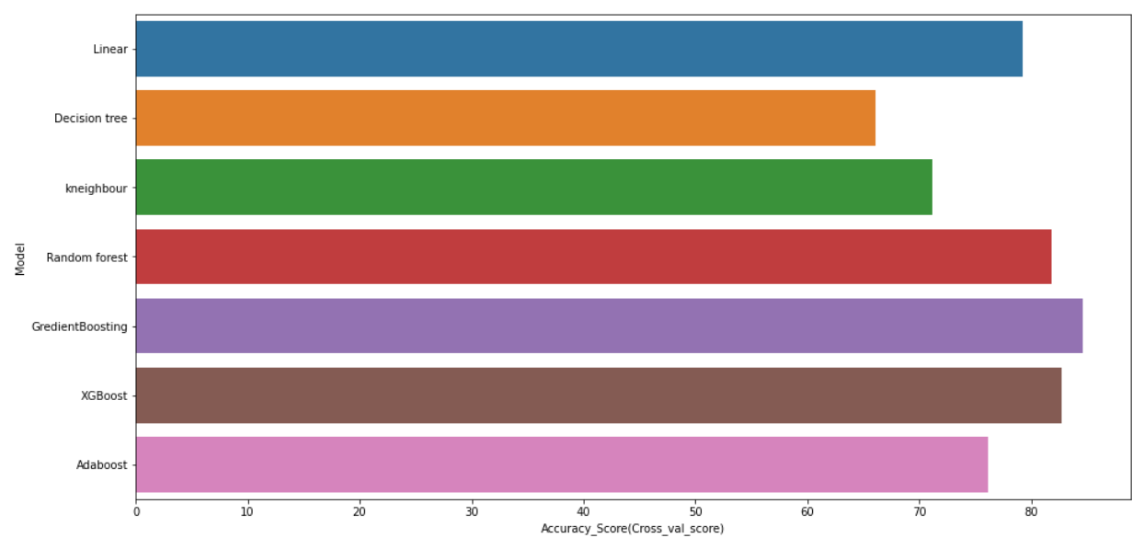
We have chosen gradient boosting regression as a best model, because this model gave us highest accuracy
Model name: Gradient Boosting Regressor
r2 score: 0.8634
Mean absolute error: 17808.20
Mean squared error: 599725527.63
Root mean squared error: 24489.29
We got 86.34 % accuracy, which can be considers as a good accuracy for predicting the house price.

Slide 11
Conclusion-
In this paper, we built serveral regression models to predict the price of some house given some of the house features. We eveluated and compared each model to determine the one with highest performance. We also looked at how some models rank the features according to their importance. In this paper, we followed the data science process starting with getting the data, then cleaning and preprocessing the data, followed by exploring the data and building models, then evaluating the results and communicating them with visualizations.
As a recommendation, we advise to use this model (or a version of it trained with more recent data) by people who want to buy a house in the area covered by the dataset to have an idea about the actual price. The model can be used also with datasets that cover different cities and areas provided that they contain the same features. We also suggest that people take into consideration the features that were deemed as most important as seen in the previous section; this might help them estimate the house price better.

